Slide 1
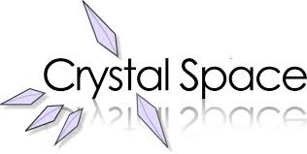
Crystal space
Submitted by – Shashwat Vidhu Sher

Slide 2
Introduction
Crystal Space is a software development kit
Used by game developers, animation developers and 3D artists to visualize 3D or 2D geometry and its interaction with the 'world‘
Written in C++
Cross Platform – runs on Mac OS X, Windows, Linux (and its flavors)

Slide 3
Support Specifications
Can render graphics, physical interactions, audio etc. by incorporating libraries like Bullet and ODE
Supports OpenGL standards and use of new functionalities like shaders
Supports the use of mesh objects with frame and bone animation support.
Support of a wide range of compilers and IDE, including Visual C++ 8, 9 & 10, gcc, Code::Blocks etc.

Slide 4
Capabilities
Crystal Space can work with number of plugins and is capable of below functionalities
Animation
Avatar expressions
Motion and collision
Detailed texture mapping
Lightmap and per-vertex lighting
Graphical user interface system through CEGUI

Slide 5
Capabilities continued…
Games
Virtual Reality
Plugin for visual debugging of scenes, support for Valgrind and CppUnit
Scripts for generation of new projects
2D and 3D sounds with OpenAL
Library of available shaders and post-processing effects: diffuse, specular, bump map, glow, parallax, fur, bloom, blur, water, glass etc.

Slide 6
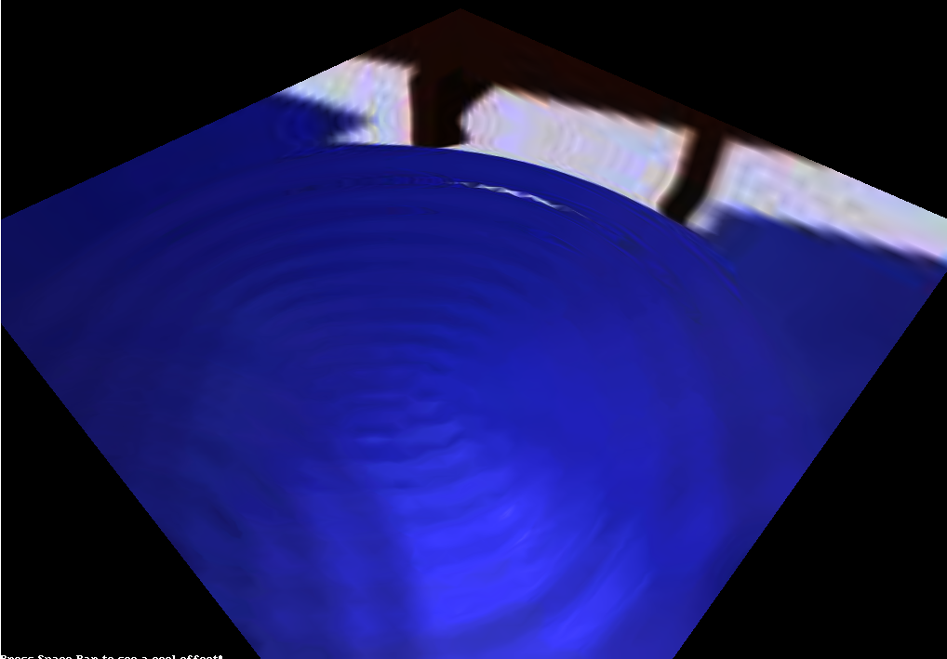
Ripples on water
Use of custom algorithm for ripple effect
No special textures
No complicated shading techniques
Generic, can be used on any type of material and texture

Slide 7
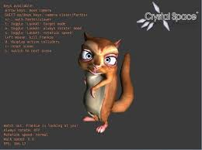
frankie – Avatar animation
Use of “LookAt” Animation Node
To look at camera
To look at random points
To look at last camera position

Slide 8
Presentation
Techniques illustrated –
Use of multiple lights
Texture mapping
Use of TesselatedBox
Collision detection
Use of maps

Slide 9
Advancing computer graphics
Twice selected as a feature project for 'Google Summer of Code‘
Arguably the best open source, computer graphics focused SDK
Extremely powerful with side projects –
Crystal Entity Layer
AresEd game editor

